Slide 1

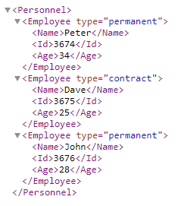
XML - Introduction
XML stands for eXtensible Markup Language.
XML was designed to store and transport data.
XML was designed to be both human- and machine-readable.
XML is a markup language much like HTML
XML was designed to be self-descriptive
XML is often used for distributing data over the Internet.
XML is just information wrapped in tags

Slide 2
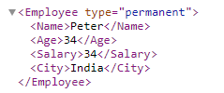
XML - Introduction
XML is Extensible – We can add new data or we can remove the existing data
Imagine an application designed to display the original version of employee.xml.
Then imagine a newer version of employee.xml we have added and removed some elements.
The way XML is constructed, older version of the application can still work:
Old
New

Slide 3
XML - Introduction
XML Advantages
XML simplifies data sharing
XML simplifies data transport
XML stores data in plain text format. This provides a software- and hardware-independent way of storing, transporting, and sharing data.
With XML, data can be available to all kinds of "reading machines" like people, computers, voice machines, news feeds, etc.

